Slide 1


Introduction to PyTorch

Slide 2
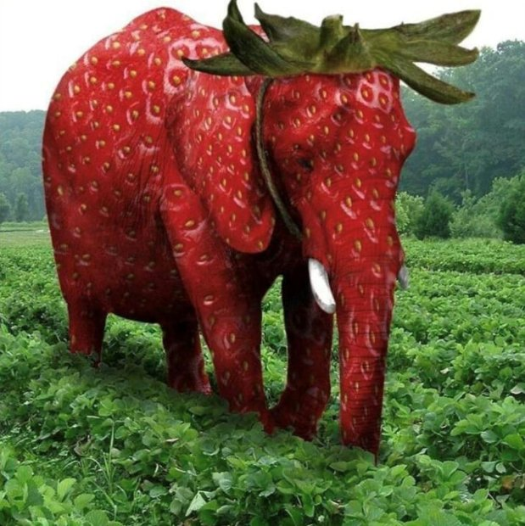
Content
Part 0: PyTorch Basics
Part 1: Basic deep learning models: MLP
Part 2: More advance deep learning models: CNN
Part 3: More advance deep learning models: RNN and LSTM

Slide 3
What is PyTorch
Developed by Facebook's AI Research lab
Primarily used for developing deep learning models
Back end is Torch
Feels like NumPy
Alternative to Googles TensorFlow

Slide 4
Graphs
Code:
Var_1=1
Var_2=44
Var_3=1+Var_1+Var_2
Var_1
Var_2
Var_3

Slide 5

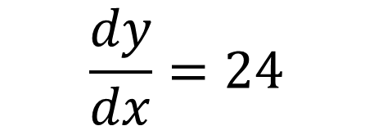
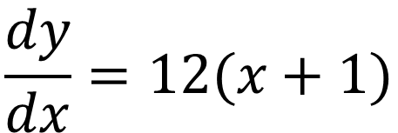


Graphs
$$x=1$$
At:
$$y=6{\left(x+1\right)}^{2}$$
$$y=24$$
$$\frac{dy}{dx}=12(x+1)$$
x
$$\frac{dy}{dx}=24$$
y

Slide 6
End of Part 0…

Slide 7
A simple model
think
question
answer

Slide 8
A simple model
process
input
output

Slide 9




A simple model
process
input
output
$$7×3$$
$$7+7=14$$
$$21$$
$$14+7=21$$

Slide 10





A simple model
$$lbs=2.2×kg$$
Predicted
$$2$$
kg
$$2$$
lbs
$$×1$$
Correct is
Error of 2.4
$$4.4$$

Slide 11


A simple model
$$lbs=2.2×kg$$
Predicted
$$2$$
kg
$$3$$
lbs
$$×2$$
Correct is
Error of 1.4
$$4.4$$

Slide 12


A simple model
$$lbs=2.2×kg$$
Predicted
$$2$$
kg
$$4.4$$
lbs
$×2$.2
Correct is
Error of 0
$$4.4$$

Slide 13
Activation function
Replicate neurons in our brains
Touching an object
5°C = not hot
10°C = not hot
…..
29°C = not hot
30°C = HOT
…..
HOT
Not hot
temp

Slide 14
Activation function non-linear
Replicate neurons in our brains
Touching an object
0=not hot, 1=HOT
5°C = 0.1
10°C = 0.2
…..
29°C = 0.4999
30°C = 0.5
100 °C =0.9999
1
0
temp

Slide 15


A bit complicated model
Input x
Calculate
Activation
Input y
output
$$a=x+y+z$$
$$h\left(a\right)$$
Input z

Slide 16
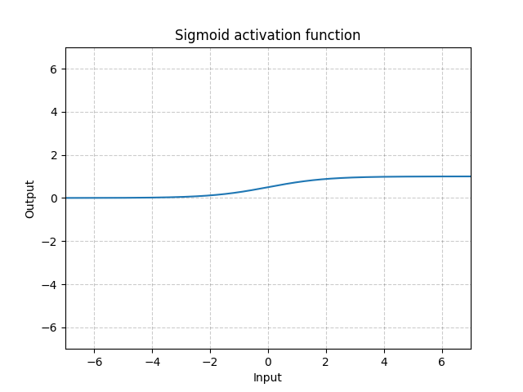
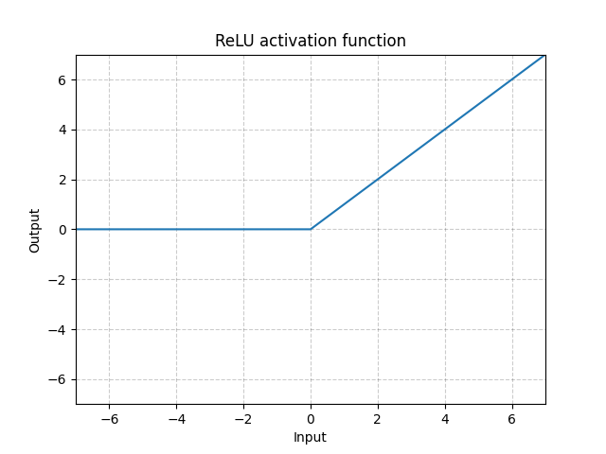
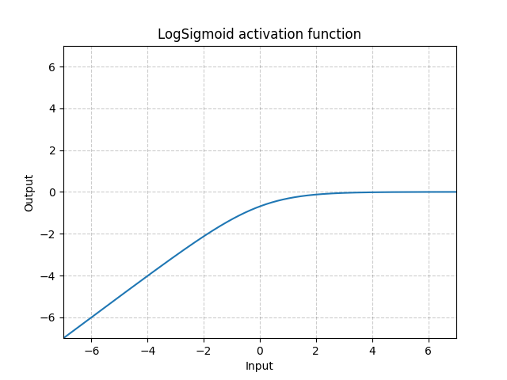
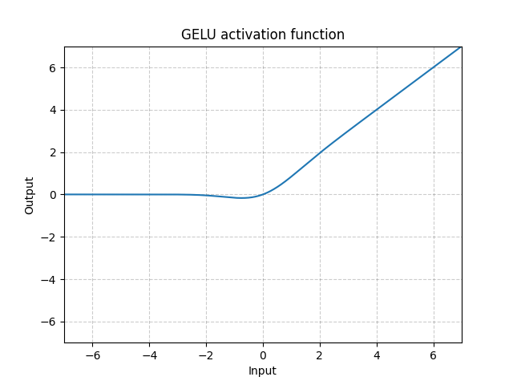
What the $h\left(a\right)$ is going on?
see

Slide 17





A bit complicated model
Input x
$${×w}_{1}$$
Calculate
Activation
$${×w}_{2}$$
Input y
$$h\left(a\right)$$
output
$$a=w_{1}x+w_{2}y+w_{3}z$$
$${×w}_{3}$$
Input z

Slide 18
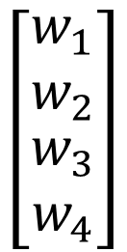


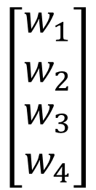

Linear part
input
output
4 dimension
1 dimension
a
b
c
d
$$\left[\begin{matrix}w_{1} \\ w_{2} \\ \begin{matrix}w_{3} \\ w_{4}\end{matrix}\end{matrix}\right]$$
$$+e$$
out
$$=w_{1}a+w_{2}b+w_{3}c+w_{4}d$$
$$\left[\begin{matrix}w_{1} \\ w_{2} \\ \begin{matrix}w_{3} \\ w_{4}\end{matrix}\end{matrix}\right]$$
$$W=$$
bias
4 x 1 matrix

Slide 19

Linear part + activation function
Activation function
input
output
4 dimension
1 dimension
a
b
c
d
$$\left[\begin{matrix}w_{1} \\ w_{2} \\ \begin{matrix}w_{3} \\ w_{4}\end{matrix}\end{matrix}\right]$$
$$={h(w}_{1}a+w_{2}b+w_{3}c+w_{4}d+e)$$
out
$$\left[\begin{matrix}w_{1} \\ w_{2} \\ \begin{matrix}w_{3} \\ w_{4}\end{matrix}\end{matrix}\right]$$
$$W=$$
4 x 1 matrix

Slide 20
One hidden layer
hidden
input
output
h( ∙ )
a
b
c
d
h( ∙ )
h( ∙ )
h( ∙ )

Slide 21
One hidden layer
hidden
input
output
h( ∙ )
a
b
c
d
h( ∙ )
h( ∙ )
h( ∙ )

Slide 22
One hidden layer
bias
bias
hidden
input
output
h( ∙ )
a
b
c
d
h( ∙ )
h( ∙ )
h( ∙ )

Slide 23







Two hidden layer
Hidden layer 1
Hidden layer 2
input
h( ∙ )
output
$$β^{\left(1\right)}$$
$$β^{\left(2\right)}$$
h( ∙ )
$$β^{\left(2\right)}$$
(1 x 5)
h( ∙ )
a
b
c
d
(1 x 3)
(1 x 1)
h( ∙ )
$$W^{\left(1\right)}$$
h( ∙ )
$$W^{\left(2\right)}$$
$$W^{\left(3\right)}$$
h( ∙ )
(4 x 5)
h( ∙ )
(5 x 3)
(3 x 1)
$$x$$
h( ∙ )
(1 x 4)

Slide 24





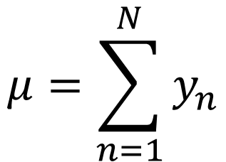

Learning?
Closed form:
Maximum likelihood
Sampling
$$y_{1,…,N}∼N\left(μ,σ^{2}\right)$$
$$μ=\sum_{n=1}^{N}{y_{n}}$$
BAYESIAN
$$P\left(y_{1,…N} | μ\right)$$
$$P\left(μ\right)$$
Prior
likelihood
$$P\left(μ|y_{1,…N}\right)∝$$
$$P\left(μ\right)$$
$$×P\left(y_{1,…N} | μ\right)$$
posterior

Slide 25


Learning? Bayesian example
Find the probability of a person having long hair
Represent the probability of a person having long hair:
If a person has long hair {1} or not long hair {0}:
$$ω∈\left[0,1\right]$$
$$y_{n}∈\left\{0,1\right\}$$

Slide 26
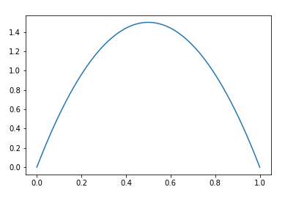
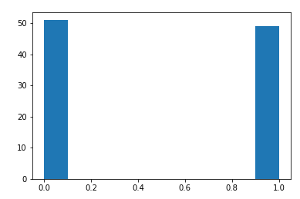
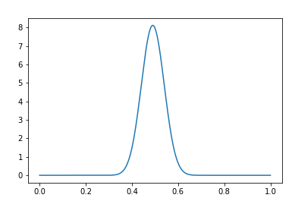





Learning? Bayesian example
$$×$$
$$ω$$
Prior
likelihood
$$∝$$
$$ω^{∗}=0.5$$
$$ω$$
posterior

Slide 27
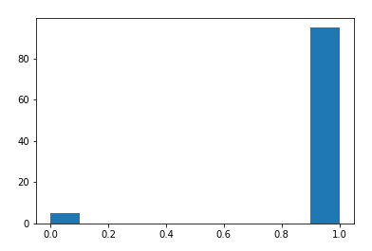
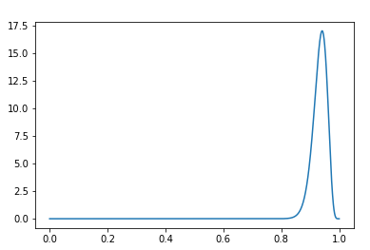

Learning? Bayesian example
$$×$$
$$ω$$
Prior
likelihood
$$∝$$
$$ω^{∗}=0.95$$
$$ω$$
posterior

Slide 28



Learning?
Optimisation
$$L\left(y_{1,…,N},w_{1,…,K}\right)=…$$
$$L\left(y_{1,…,N}\right)$$
$$w_{k}$$

Slide 29
Learning?
Optimisation
$$L\left(y_{1,…,N},w_{1,…,K}\right)=…$$
$$L\left(y_{1,…,N}\right)$$
$$w_{k}$$

Slide 30
Learning?
Optimisation
$$L\left(y_{1,…,N},w_{1,…,K}\right)=…$$
$$L\left(y_{1,…,N}\right)$$
$$w_{k}$$

Slide 31
Learning?
Optimisation
$$L\left(y_{1,…,N},w_{1,…,K}\right)=…$$
$$L\left(y_{1,…,N}\right)$$
$$w_{k}$$

Slide 32
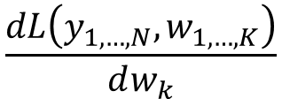
Learning?
Optimisation:
Gradient
$$L\left(y_{1,…,N},w_{1,…,K}\right)=…$$
$$\frac{dL\left(y_{1,…,N},w_{1,…,K}\right)}{dw_{k}}$$
$$L\left(y_{1,…,N}\right)$$
$$w_{k}$$

Slide 33
Learning?
Optimisation:
Gradient
$$L\left(y_{1,…,N},w_{1,…,K}\right)=…$$
$$\frac{dL\left(y_{1,…,N},w_{1,…,K}\right)}{dw_{k}}$$
$$L\left(y_{1,…,N}\right)$$
$$w_{k}$$

Slide 34
Learning?
Optimisation:
Gradient
$$L\left(y_{1,…,N},w_{1,…,K}\right)=…$$
$$\frac{dL\left(y_{1,…,N},w_{1,…,K}\right)}{dw_{k}}$$
$$L\left(y_{1,…,N}\right)$$
$$w_{k}$$

Slide 35
Learning?
Optimisation:
Gradient
$$L\left(y_{1,…,N},w_{1,…,K}\right)=…$$
$$\frac{dL\left(y_{1,…,N},w_{1,…,K}\right)}{dw_{k}}$$
$$L\left(y_{1,…,N}\right)$$
$$w_{k}$$

Slide 36
A complex
process
process
process
process
process
Input(s)
process
process
Output(S)
process

Slide 37
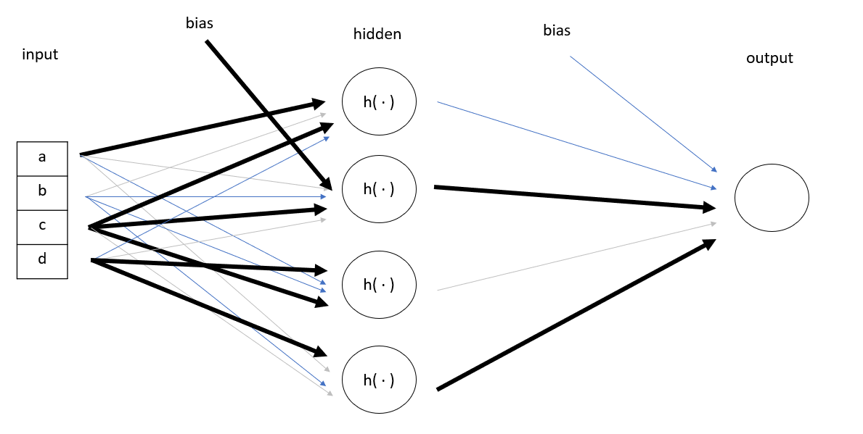
Backbox?
Black box
process
process
process
process
process
Input(s)
process
process
Output(S)
process

Slide 38
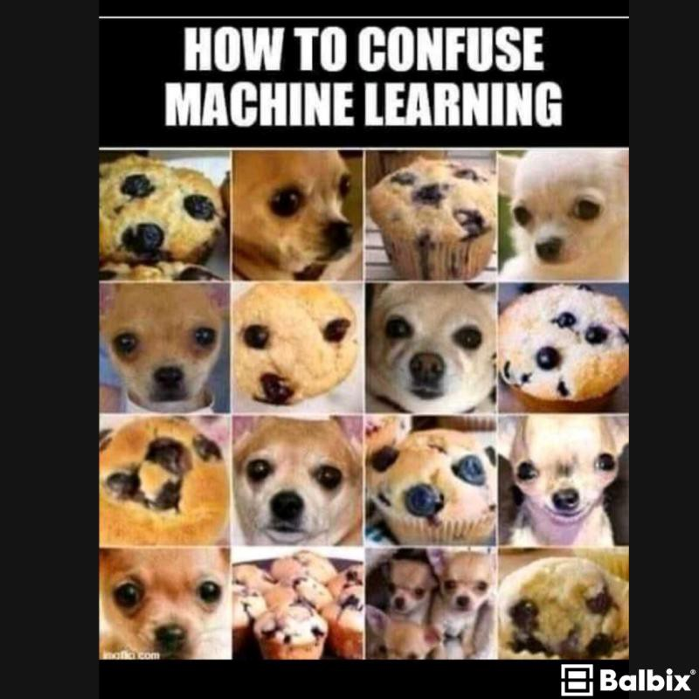
Images
32
0 = white, 255= black
32
=32 x 32 =1024
…
1 x 1024

Slide 39
Images
32
0 = white, 255= black
32
=32 x 32 =1024
…
…
N x 1024
…

Slide 40
A complex
dog
process
process
process
process
process
input
process
process
output
process

Slide 41
A complex
dog
process
process
process
process
process
input
process
process
output
process

Slide 42
A complex
dog
process
process
process
process
process
input
process
process
output
process

Slide 43
A complex
dog
process
process
process
process
process
input
process
process
output
process

Slide 44
Why?
Complicated models learn other patterns
For example: “can you organise 100 files please”
Bad assistant: Done 5
Okay assistant: Done 50
Good assistant: Done 100
Where are the pens?
Where are the folders?
My emails?
Good assistant: “I was free do did other stuff”

Slide 45
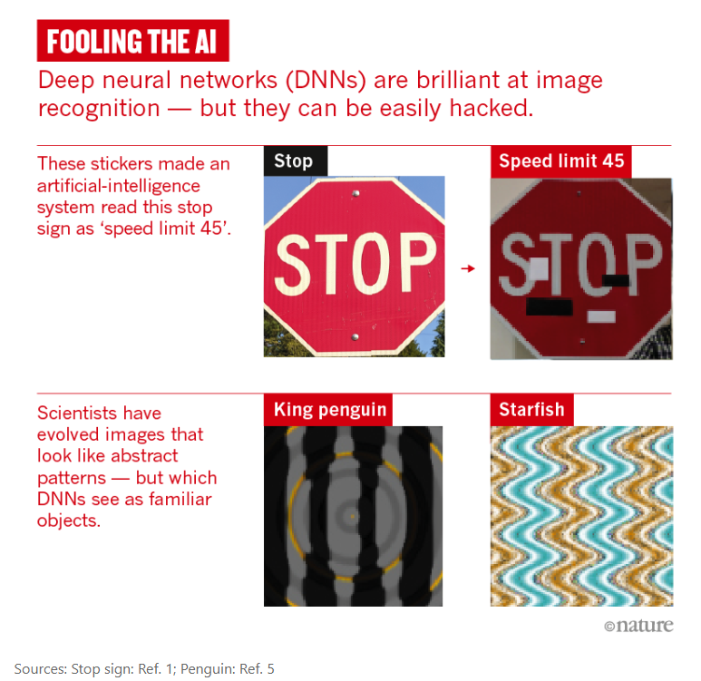
Why?
Why deep-learning AIs are so easy to fool
https://www.nature.com/articles/d41586-019-03013-5

Slide 46
Why?
Why deep-learning AIs are so easy to fool
https://www.nature.com/articles/d41586-019-03013-5

Slide 47
End of Part 1…

